Slide 1
Bayesian graph convolutional neural networks for semi-supervised classification
Yingxue Zhang, Soumyasundar Pal, Mark Coates, Deniz Ustebay
Reporter: Zhengying Xing

Slide 2
1
Background
2
Motivation
outlines
3
Model
4
Experiment
5
Conclusion

Slide 3
1
Background
2
Motivation
outlines
3
Model
4
Experiment
5
Conclusion

Slide 4
Background
1
A significant body of research focuses on using neural networks to analyze structured data when there is an underlying graph describing the relationship between data items.
For example:
Paper A sited B and D, and paper B sited C.
The relationship between the papers can be easily expressed by a graph:
B
A
C
D

Slide 5
Early work:
Graph neural network(GNN) :
Rely on recursive processing and propagation of information across the graph
Training can often take a long time to converge and the required time scales undesirably with respect to the number of nodes in the graph

Slide 6
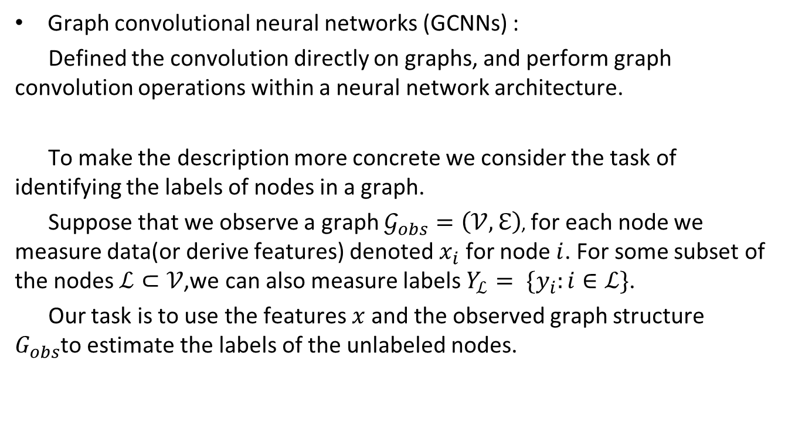
Graph convolutional neural networks (GCNNs) :
Defined the convolution directly on graphs, and perform graph convolution operations within a neural network architecture.
To make the description more concrete we consider the task of identifying the labels of nodes in a graph.
Suppose that we observe a graph $𝒢_{obs}=\left(𝒱,ℇ\right)$, for each node we measure data(or derive features) denoted $x_{i}$ for node $i$. For some subset of the nodes $ℒ⊂𝒱$,we can also measure labels $Y_{ℒ}= \{y_{i}:i∈ℒ\}$.
Our task is to use the features$x$and the observed graph structure $G_{obs}$to estimate the labels of the unlabeled nodes.

Slide 7
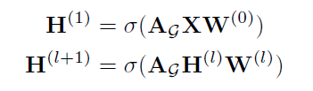
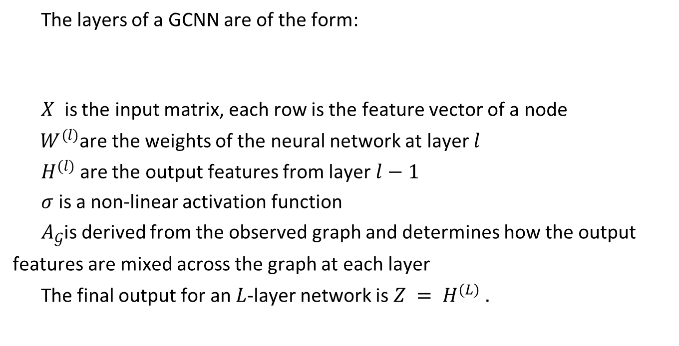
The layers of a GCNN are of the form:
$X$ is the input matrix, each row is the feature vector of a node
$W^{(l)}$are the weights of the neural network at layer $l$
$H^{(l)}$ are the output features from layer $l−1$
$σ$is a non-linear activation function
$A_{𝒢}$is derived from the observed graph and determines how the output
features are mixed across the graph at each layer
The final output for an $L$-layer network is $Z = H^{(L) }.$

Slide 8


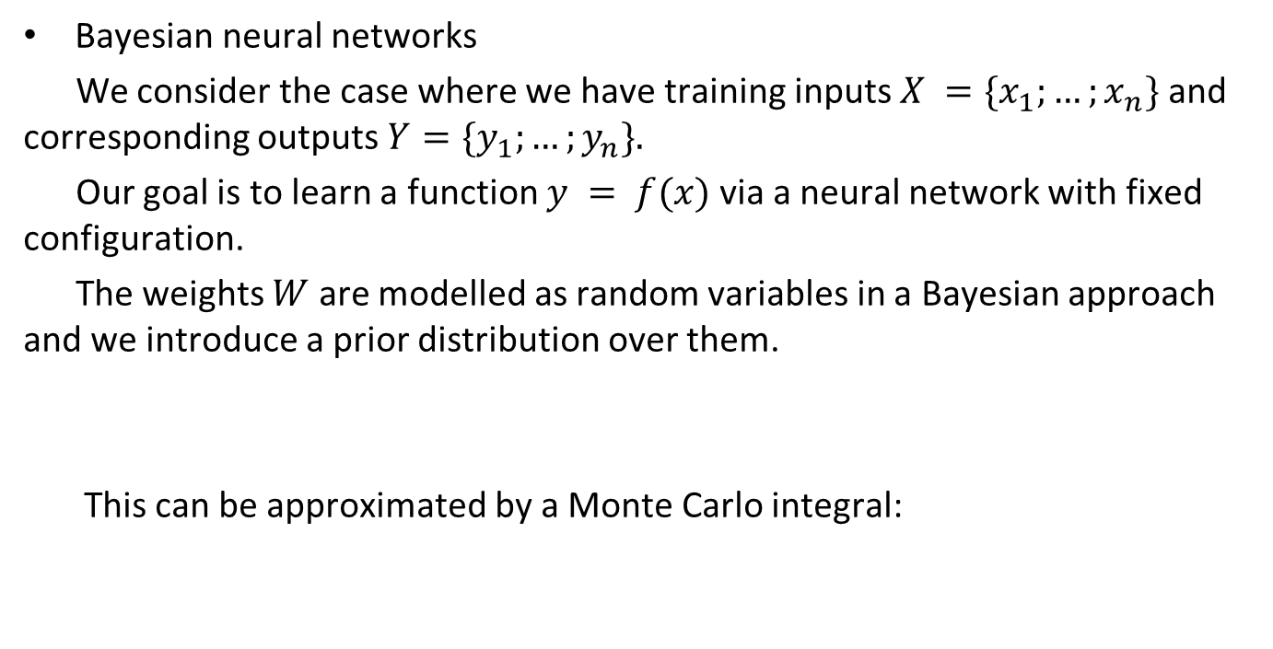
Bayesian neural networks
We consider the case where we have training inputs $X =\{x_{1};…;x_{n}\}$and corresponding outputs $Y=\{y_{1};…;y_{n}\}.$
Our goal is to learn a function $y = f(x)$via a neural network with fixed configuration.
The weights $W$ are modelled as random variables in a Bayesian approach and we introduce a prior distribution over them.
This can be approximated by a Monte Carlo integral:

Slide 9
1
Background
2
Motivation
outlines
3
Model
4
Experiment
5
Conclusion

Slide 10
Motivation
Although there are many different flavors of GCNNs, all current versions process the graph as though it is a groundtruth depiction of the relationship between nodes.
This is despite the fact that in many cases the graphs employed in applications are themselves derived from noisy data or modelling assumptions.
Spurious edges may be included; other edges may be missing between nodes that have very strong relationships.

Slide 11
1
Background
2
Motivation
outlines
3
Model
4
Experiment
5
Conclusion

Slide 12




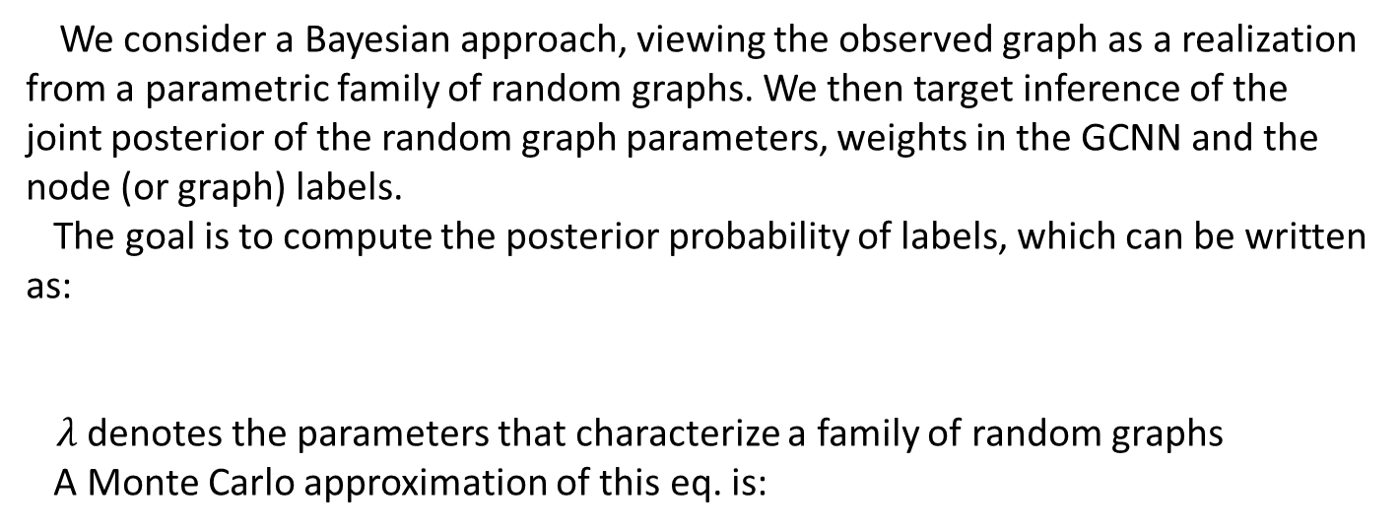
Model
We consider a Bayesian approach, viewing the observed graph as a realization from a parametric family of random graphs. We then target inference of the joint posterior of the random graph parameters, weights in the GCNN and the node (or graph) labels.
The goal is to compute the posterior probability of labels, which can be written as:
$λ$denotes the parameters that characterize a family of random graphs
A Monte Carlo approximation of this eq. is:

Slide 13
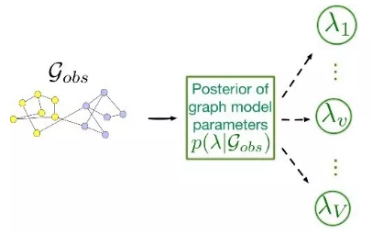
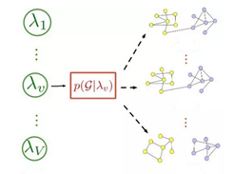
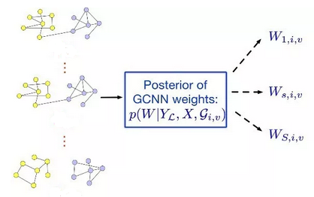





$$𝒢_{1,v}$$
$$𝒢_{1,v}$$
$$𝒢_{i,v}$$
$$𝒢_{i,v}$$
$$𝒢_{N_{G},v}$$
$$𝒢_{N_{G},v}$$

Slide 14


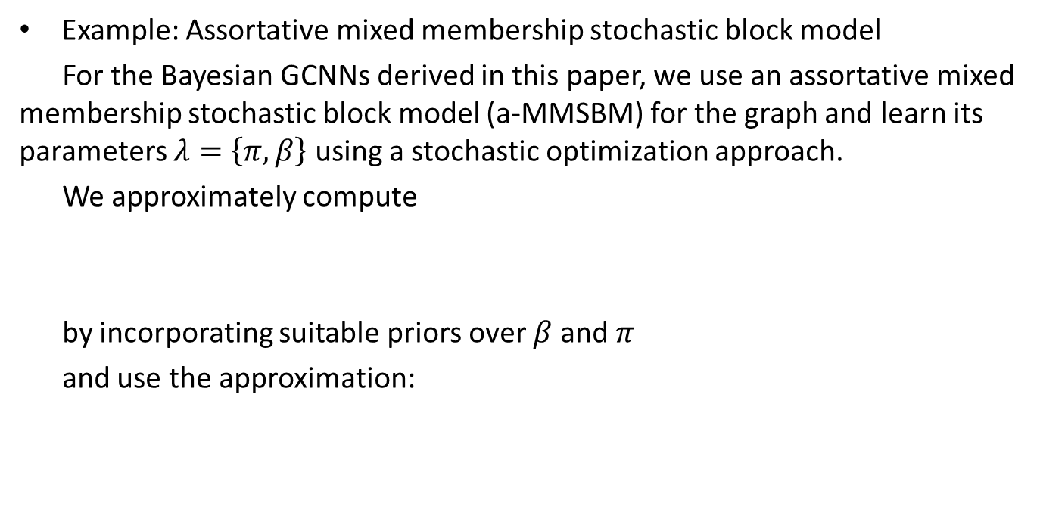
Example: Assortative mixed membership stochastic block model
For the Bayesian GCNNs derived in this paper, we use an assortative mixed membership stochastic block model (a-MMSBM) for the graph and learn its parameters $λ=\left\{π,β\right\}$ using a stochastic optimization approach.
We approximately compute
by incorporating suitable priors over $β$and $π$
and use the approximation:

Slide 15
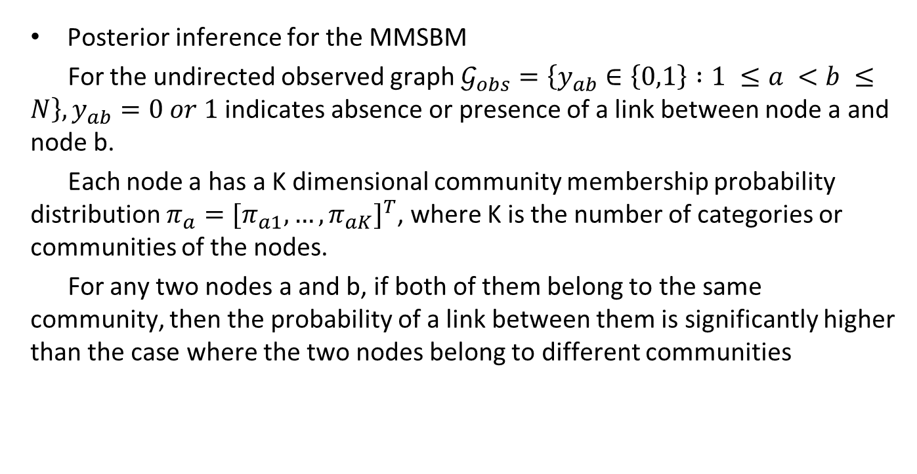
Posterior inference for the MMSBM
For the undirected observed graph $𝒢_{obs}=\left\{y_{ab}∈\left\{0,1\right\} :1 ≤a <b ≤N\right\}, y_{ab}=0 or 1$ indicates absence or presence of a link between node a and node b.
Each node a has a K dimensional community membership probability distribution $π_{a}={[π_{a1},…,π_{aK}]}^{T}$, where K is the number of categories or communities of the nodes.
For any two nodes a and b, if both of them belong to the same community, then the probability of a link between them is significantly higher than the case where the two nodes belong to different communities

Slide 16


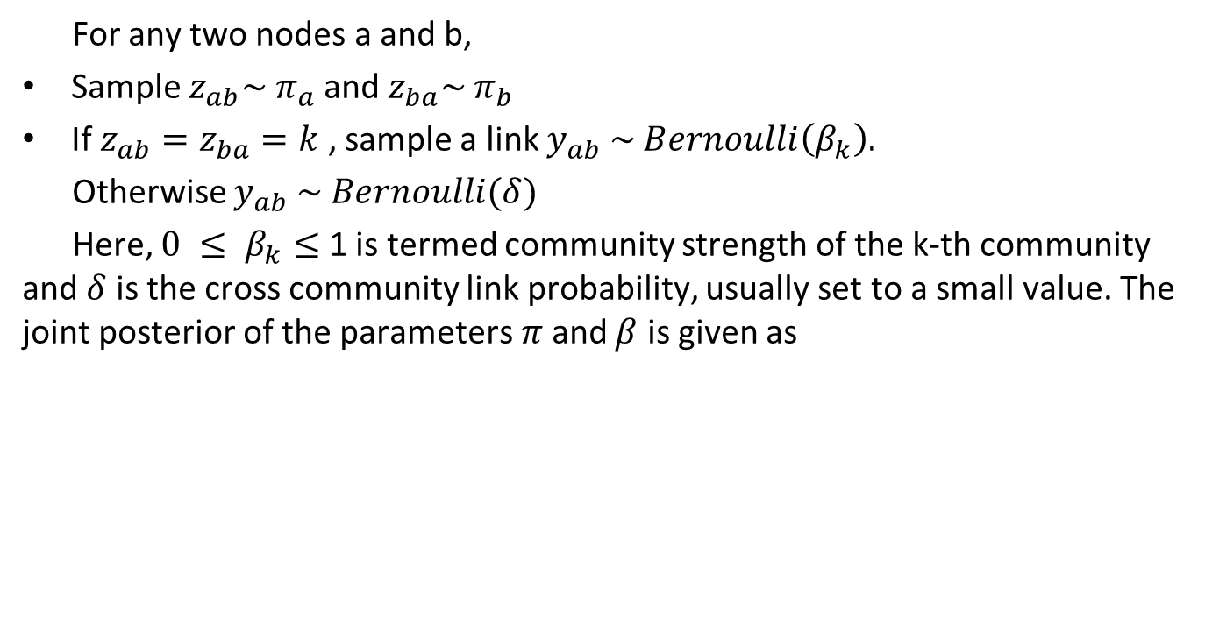
For any two nodes a and b,
Sample $z_{ab}\sim π_{a}$ and $z_{ba}\sim π_{b}$
If $z_{ab}=z_{ba}=k$ , sample a link $y_{ab} \sim Bernoulli\left(β_{k}\right).$
Otherwise $y_{ab} \sim Bernoulli(δ)$
Here, $0 ≤ β_{k}≤$ 1 is termed community strength of the k-th community and $δ$ is the cross community link probability, usually set to a small value. The joint posterior of the parameters$π$and $β$ is given as

Slide 17


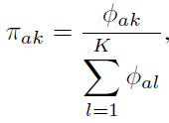
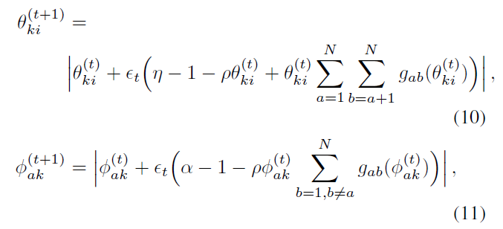

We have the constraints:
So we introduce the alternative parameters $θ,φ$
And update the above eq. iteratively

Slide 18
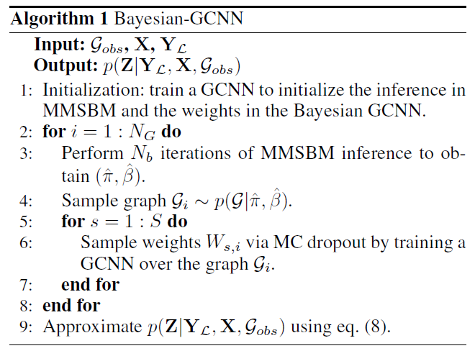

Slide 19
1
Background
2
Motivation
outlines
3
Model
4
Experiment
5
Conclusion

Slide 20
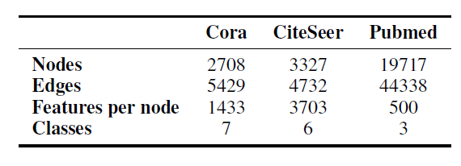
Experiment
We explore the performance of the proposed Bayesian GCNN on three well-known citation datasets : Cora, CiteSeer, and Pubmed.
In these datasets each node represents a document and has a sparse bag-of-words feature vector associated with it. Edges are formed whenever one document cites another.
Each node label represents the topic that is associated with the document.
We assume that we have access to several labels per class and the goal is to predict the unknown document labels.

Slide 21
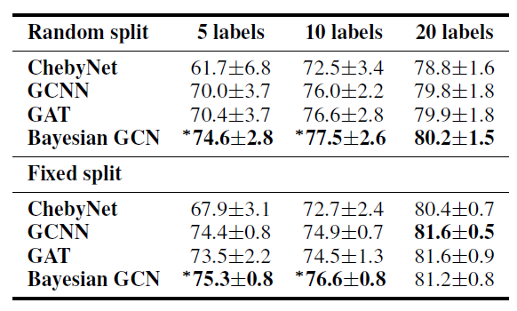
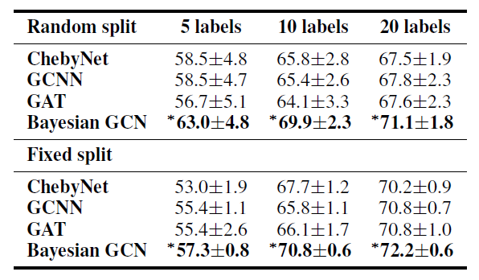
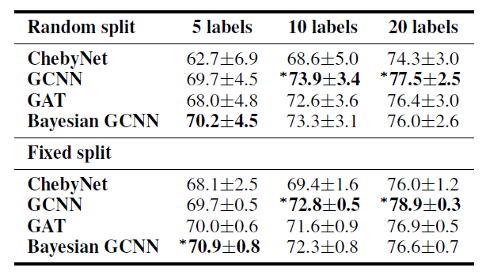
Core dataset
Citeseer dataset
The Pubmed dataset has a much lower intra-community density than the other datasets and a heavy-tailed degree distribution. The assortative MMSBM is thus a relatively poor choice for the observed graph.
Pubmed dataset

Slide 22

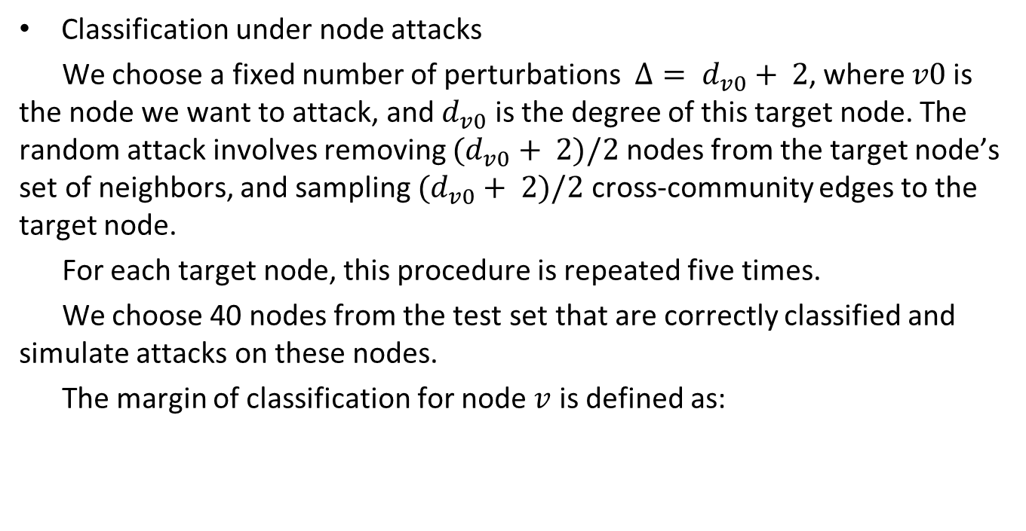
Classification under node attacks
We choose a fixed number of perturbations $Δ= d_{v0}+ 2$, where $v0$is the node we want to attack, and $d_{v0}$ is the degree of this target node. The random attack involves removing $(d_{v0}+ 2)/2$ nodes from the target node’s set of neighbors, and sampling $(d_{v0}+ 2)/2$ cross-community edges to the target node.
For each target node, this procedure is repeated five times.
We choose 40 nodes from the test set that are correctly classified and simulate attacks on these nodes.
The margin of classification for node $v$ is defined as:

Slide 23
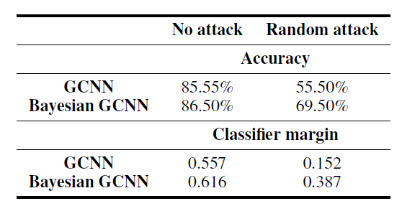
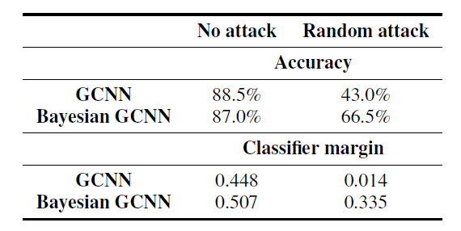
For each algorithm we choose the 10 nodes with the highest margin of classification and 10 nodes with the lowest positive margin of classification. The remaining 20 nodes are selected at random from the set of nodes correctly classified by both algorithms.
Cora dataset
Citeseer dataset

Slide 24
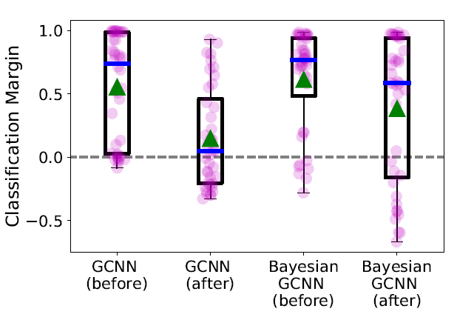
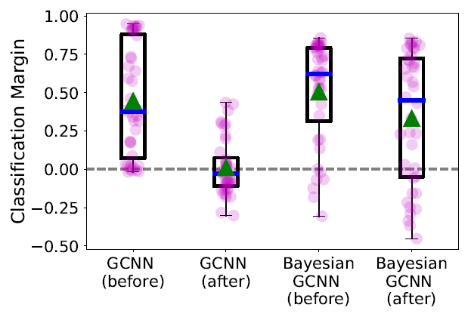
Cora dataset
Citeseer dataset

Slide 25
1
Background
2
Motivation
outlines
3
Model
4
Experiment
5
Conclusion

Slide 26
Conclusion
In this paper we have presented Bayesian graph convolutional neural networks, which provide an approach for incorporating uncertain graph information through a parametric random graph model.
We provided an example of the framework for the case of an assortative mixed membership stochastic block model and explained how approximate inference can be performed.
We explored the performance of the Bayesian GCNN for the task of semi-supervised node classification.
We also compared the robustness of Bayesian GCNNs and standard GCNNs
under an adversarial attack involving randomly changing a subset of the edges of node.

Slide 27
Thank you

